Slide 1
REBOUND AND RECYCLE
Joe Stoica, Ryan Miller, Andy Jedlicka

Slide 2
THE PROBLEM
Recyclable materials accumulate quickly, but may not be recycled correctly.
Nonrenewable resources are threatened when recycling is unavailable
Waste accumulates in undesirable ways
How can we get people to recycle more?
Notes:
Classrooms might not recycle correctly if they even have recycling available
We could eventually run out of the materials we’re used to using every day
Things that could be recycled instead end up in landfills

Slide 3
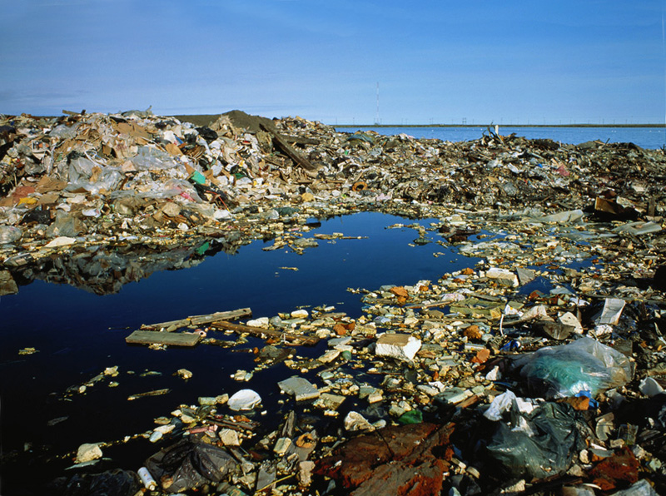
http://www.ponzaracconta.it/wp-content/uploads/2016/08/The-great-Pacific-garbage-patch.jpg
Notes:
This is the Great Pacific Garbage patch. It is twice the size of Texas. Water basically swirls in a huge current and gets collected in one area

Slide 4
THE SOLUTION
Encourage recycling by making it into a game.
Participants will increase their displayed score by recycling more material. This project aims to make recycling rewarding.
Prizes could be awarded if goal is hit
Aims to further educate the players on community recycling operations and environmental benefits.

Slide 5
PROPOSAL CHANGES
We went from two bins to one
Cost
Time
Unnecessary complexity
Instead of teams, make it a group effort with a time constraint

Slide 6
PREVIOUS RECYCLING INITIATIVES
Coca Cola recycling game
Sweden’s Recycling program
Recycles 99% of waste
“950,000 Swedish households are heated by the energy produced by the system, and 260,000 households are powered by it.”
Import 800,000 tons of waste from other countries
Source: https://inhabitat.com/sweden-now-recycles-a-staggering-99-percent-of-its-garbage/
Notes:
https://www.youtube.com/watch?v=UA7tGcABUZs just in case the link above doesn’t work

Slide 7
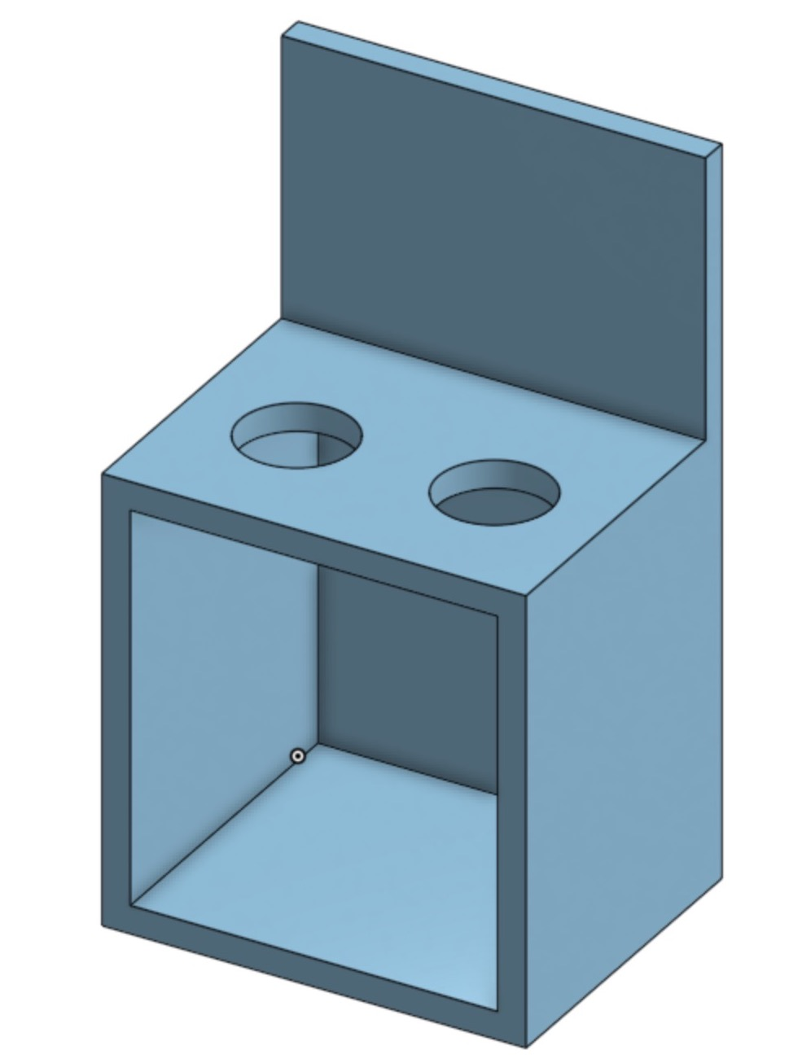
ORIGINAL SKETCHES
Two bins
Box containing electronics behind
Cabinet-like doors on front to access bins

Slide 8
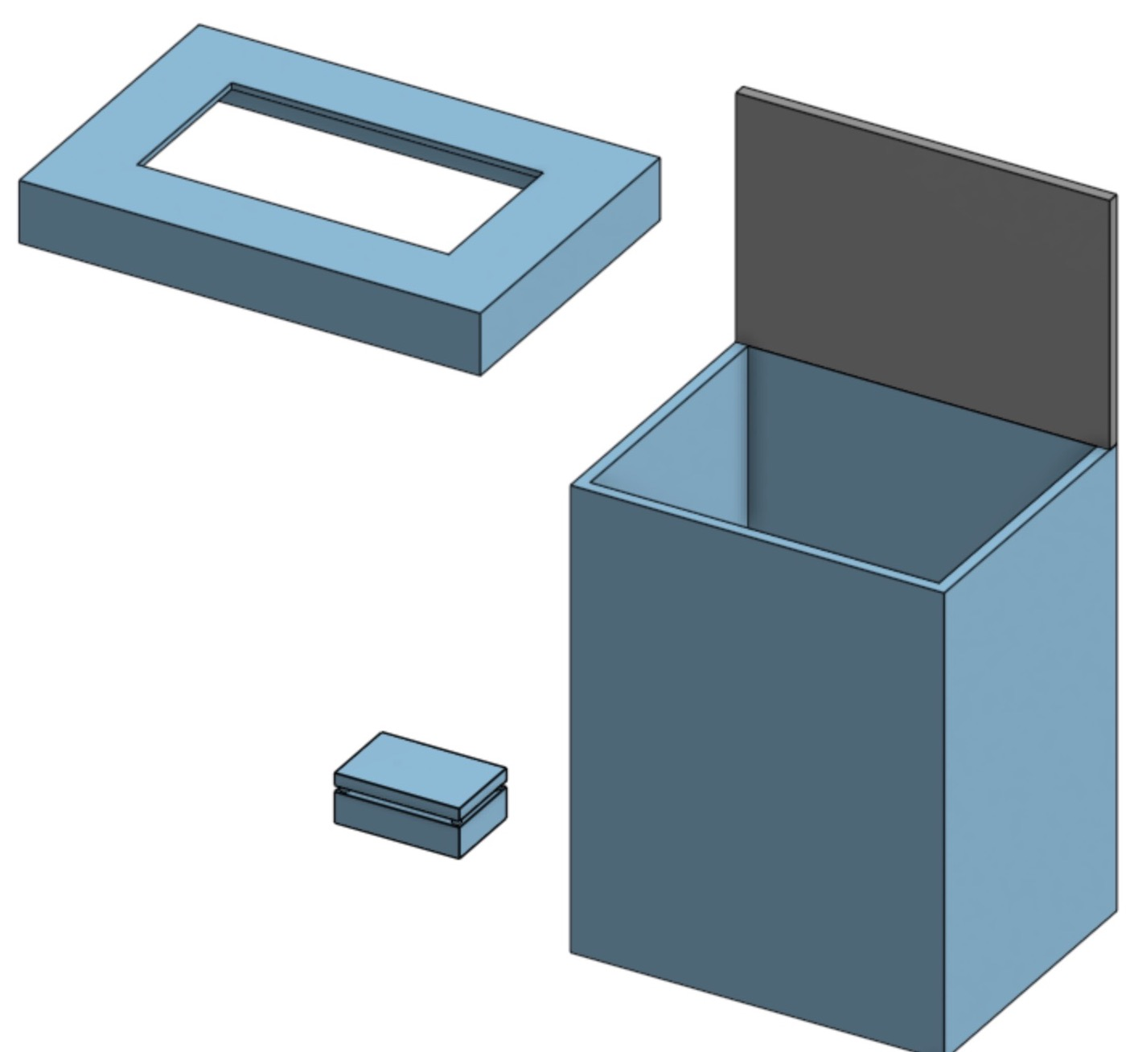
CURRENT SKETCH
Electronics box and scale one piece
Lid now removable
Bigger hole for waste

Slide 9
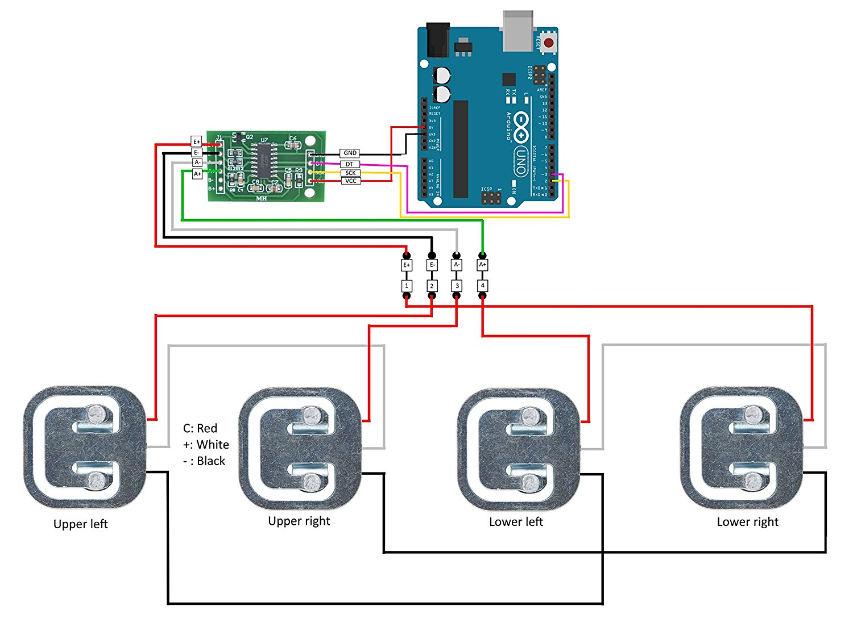
WEIGHT SENSOR FRITZING
https://www.amazon.com/Degraw-amplifier-weight-Arduino-Bathroom/dp/B075Y5R7T7/ref=pd_sbs_23_3?_encoding=UTF8&pd_rd_i=B075Y5R7T7&pd_rd_r=MXVQFYFQ9R52N5K2AQGN&pd_rd_w=guo4w&pd_rd_wg=yOKFv&psc=1&refRID=MXVQFYFQ9R52N5K2AQGN

Slide 10
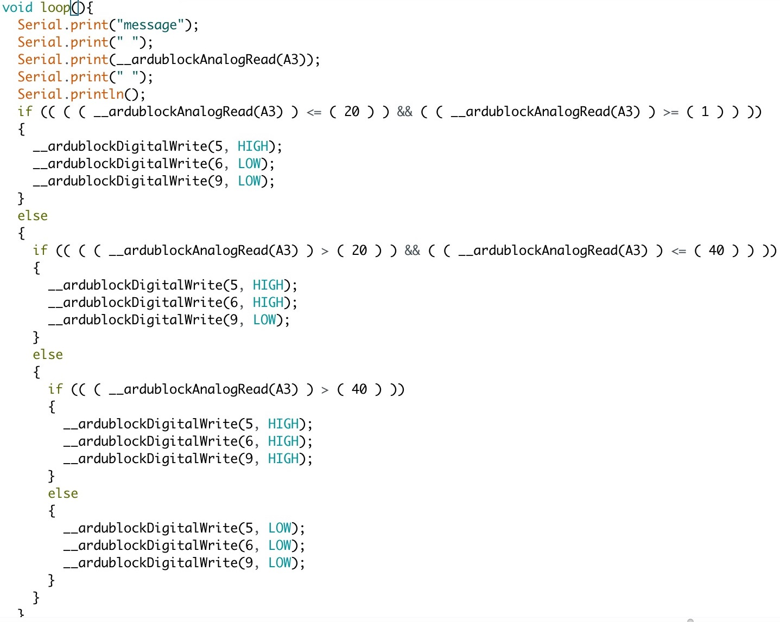
OUR CODE
Conditionals to test when new weights are sensed
Light up LEDs when necessary

Slide 11
BETA LOGISTICS
Experiment on Sohile’s Floor
Control – Regular Recycling
Treatment – R&R with incentive

Slide 12
STATUS UPDATE
Not very behind where we want to be
Fried Arduino Uno
Original weight sensors were not ideal, new sensors on the way

Slide 13
FUTURE WORK
LED Array almost complete
Have to design patterns through array data structure
Weight sensor hookup and construct box

